Slide 1
People Analytics
Day 6 – 21/03/2022

Slide 2
CAREER MANAGEMENT

Slide 3
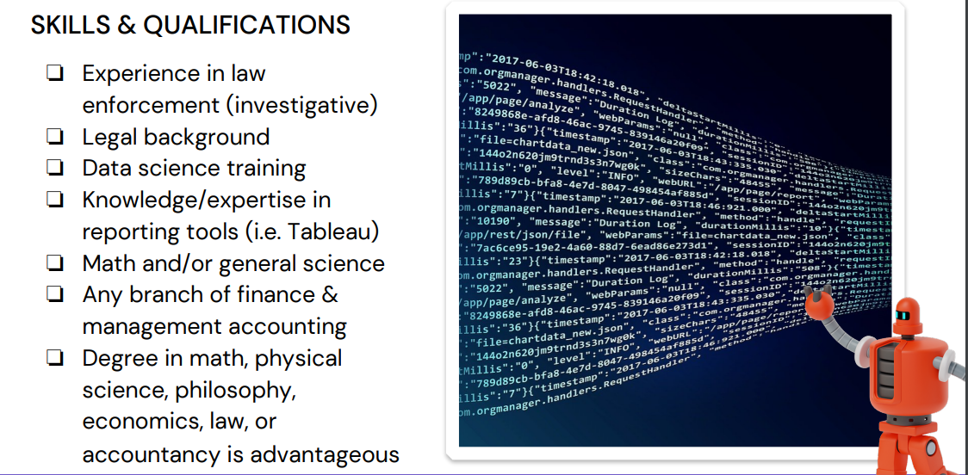
Manage the career

Slide 4

Manage the career
Career path : based on previous experience, compétences, interest, AI propose career path and push internal positions to employees
Career interview : same way than performance management, 1 / year
Video : Career Management and IA

Slide 5
OFF BOARDING

Slide 6
Manage the offboarding
General Statistics:
15% of employees have boomeranged back to a former employer
20% of organizations say they’ve experienced a data breach that’s linked to former employees
Despite these risks only 29% of organizations have a formal offboarding process

Slide 7

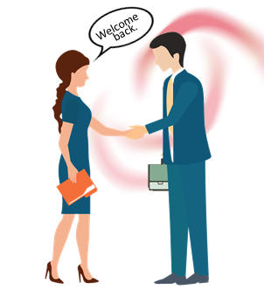
Manage the offboarding
Offboarding is important because it mitigates security risks and is beneficial to the business’ brand :
Security / Compliance:
Given that the majority of data breaches are caused by human error, and most former employees still have access to their work account one or few days after leaving, maintaining security can become a huge issue.
Offboarding allows companies to remove old accounts and ensure that all account-related ties are cut with former employees.
Branding : Having an effective offboarding process often leaves a more positive impression on former employees, making them more likely to write positive reviews about your business and report positive feedback to others.
Networking : a proper offboarding process can help employers keep track of contact information and ultimately maintain beneficial networking relationships (alumni).
Employee experience :
offboarding is necessary to appropriately wrap up the employee life cycle. Offboarding covers all the required tasks, paperwork, assets recovery and legal requirements while also ending the employment relationship on good terms.
Departing employees get their last impression of the company during offboarding. No matter what led to their exit, offboarding can send them on their way with respect and professionalism.

Slide 8
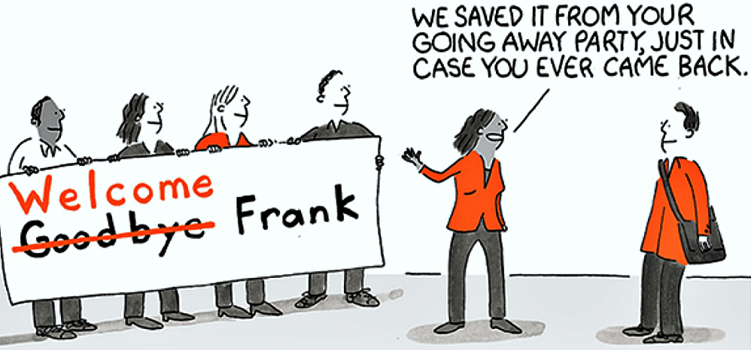
Manage the offboarding
What is a good offboarding process?
A good offboarding process ensures anticipation, communication, coordination and security. The main steps include:
Managing leaver’s departure communication internally & externally
Informing internal stakeholders with anticipation to ensure all actions coordination prior to effective termination date
Informing employee of termination procedure & conditions (final paycheck, benefits, returning company-owned equipment etc.)
Planning the handover, knowledge transfer and employee’s responsibilities transfer
Conducting an exit interview
Leaving a positive impression and encourage a fruitful networking connection

Slide 9
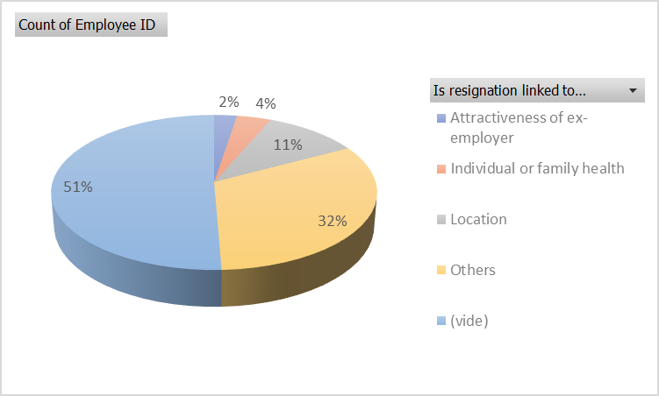
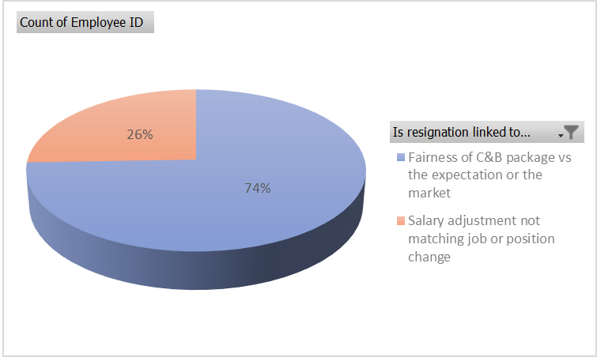
Manage the offboarding
KPIs :
Exit interview
% or notations in differents items :
Career => promotion,..
Compensation => salary, benefits
Personal => family, ..
Environment => management, work conditions
Overall recommandation of the company to other people
Turnover
Nb resignation / average headcount *100

Slide 10
Exercise
Company ABC – 1300 employees
With the 2 tabs of the file, define the turnover rate per country
Analyze the Exit interview statistics of 2022
File in e-campus

Slide 11
REMINDER

Slide 12

People Analytics goals
« The ultimate goal of people analytics is to provide meaningful insights on various types of people- and HR data, and by providing that information, actively contribute to the business. »

Slide 13
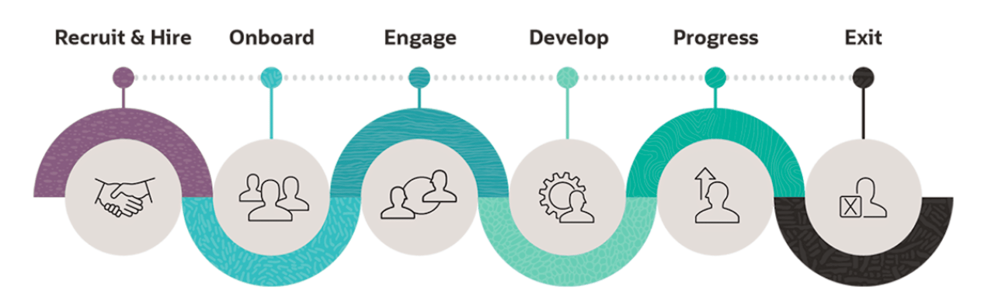
Reminder

Slide 14
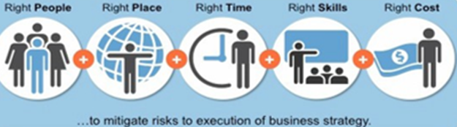
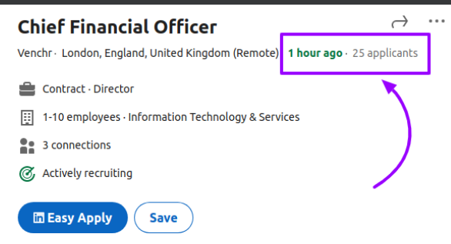
Reminder
PLAN (Workforce Planning & Budget)
RECRUIT & HIRE

Slide 15


Reminder
ONBOARD
ENGAGE

Slide 16


Reminder
DEVELOP
PROGRESS

Slide 17

Reminder
OFFBOARD (EXIT)

Slide 18
HR KPIs
Workforce planning:
% Adherence vs budget / workforce planning (in Headcount, FTE, Labor costs)
Learning
Nb of Learning hours / employee
Learning NPS
% Learning compliant / certification
Career management
% internal mobility
% employee with a career discussion
% employee or positions with a succession planning
Recruiting:
Time to Hire
Sourcing Channel Efficiency
Number of Qualified Candidates
Submit to Interview Ratio
Interview to Offer Ratio
Offer Acceptance Rate
Cost Per Hire
Quality of Hire (Pre-hire & post-hire quality)
Hires to Goal per recruiter
Candidate Net Promoter Score (NPS)
People engagement:
Employee NPS (e-NPS, scoring 1 to 10)
Engagement survey score
Absenteeism
Turnover (per country, per seniority,..)
Diverse:
Demographic (age pyramid,..)
Diversity & Inclusion
Well being

